Slide 1



PROJECT 2
GRAB APP REVIEWS SENTIMENT ANALYSIS
GROUP D
WAN NUR SOFEA BINTI MOHD HASBULLAH (A22EC0115)
LOW YING XI (A22EC0187)
MUHAMMAD ARIFF DANISH BIN HASHNAN (A22EC0204)
MUHAMMAD IMAN FIRDAUS BIN BAHARUDDIN (A22EC0216)

Slide 2



APACHE KAFKA
STREAM PIPELINE

Slide 3
REAL-TIME STREAM PIPELINE OVERVIEW
Why and How Kafka Integrated into the Project
Key Roles of Kafka in the Pipeline
Data Ingestion
Reviews extracted using google-play-scraper library.
Sent to Kafka topic grab_reviews_final in JSON format
Decoupling Components
Enables asynchronous communication between data producers (scraper) and consumers (Spark).
Scalability & Fault Tolerance
Supports high volume of data (over 448,000 reviews collected).
Built-in fault tolerance with replication and partitioning.
Acts as a high-throughput message broker for real-time data streaming
Used to capture and stream app review data from Google Play Store to downstream processing systems.

Slide 4
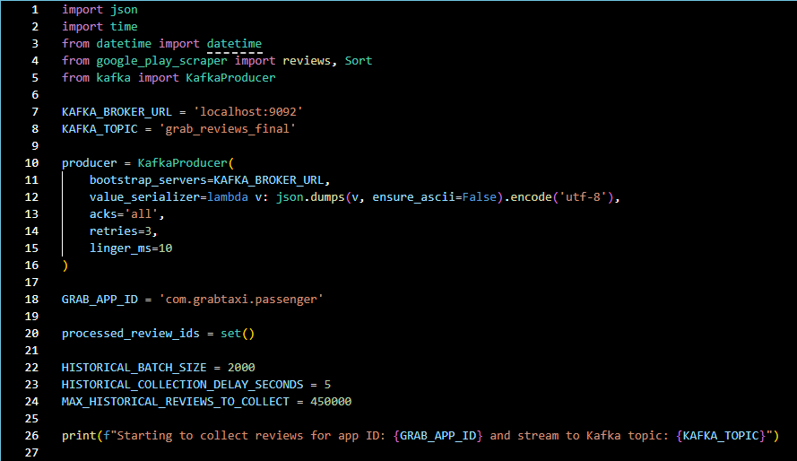
KAFKA PRODUCER IMPLEMENTATION
Kafka Producer Script: grab_review_producer.py
Extracts reviews in batches of 2000 with a 5-second delay.
Prevents duplication by checking review_id before sending to Kafka.
Kafka Producer Workflow
Scrape Grab App reviews from Google Play Store.
Format data into JSON.
Send to Kafka topic: grab_reviews_final.
Ensure data quality by avoiding duplicates.

Slide 5
PREPROCESSING DATA (NLP LIBRARIES & TECHNIQUES)

Slide 6


LIBRARIES USED
pyspark.sql.SparkSession
pyspark.sql.functions
Initializes the Spark environment for processing big data
Provides functions to manipulate and clean text such as lower(), regexp_replace(), trim(), etc
pyspark.ml.feature
Tokenizer : Splits text into words.
StopWordsRemover : Removes common words like "the", "is", "and".
HashingTF : Converts text to numerical vectors (term frequency).
IDF : Weights terms based on their importance (inverse document frequency).

Slide 7
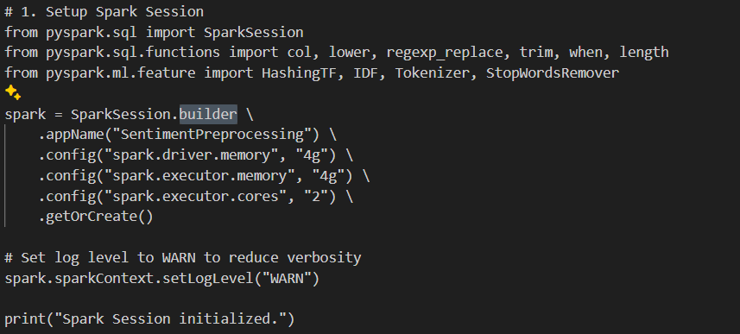
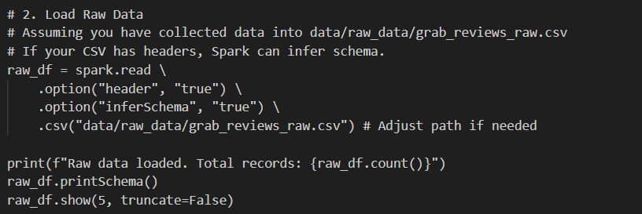
STEP 1
STEP 2

Slide 8
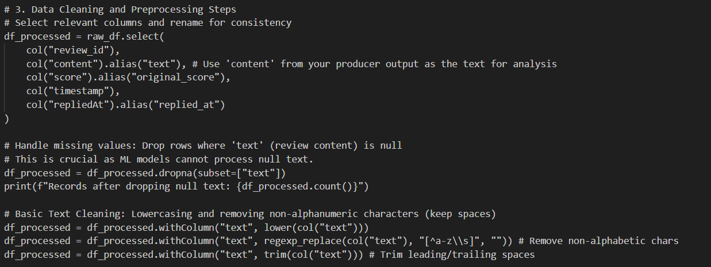
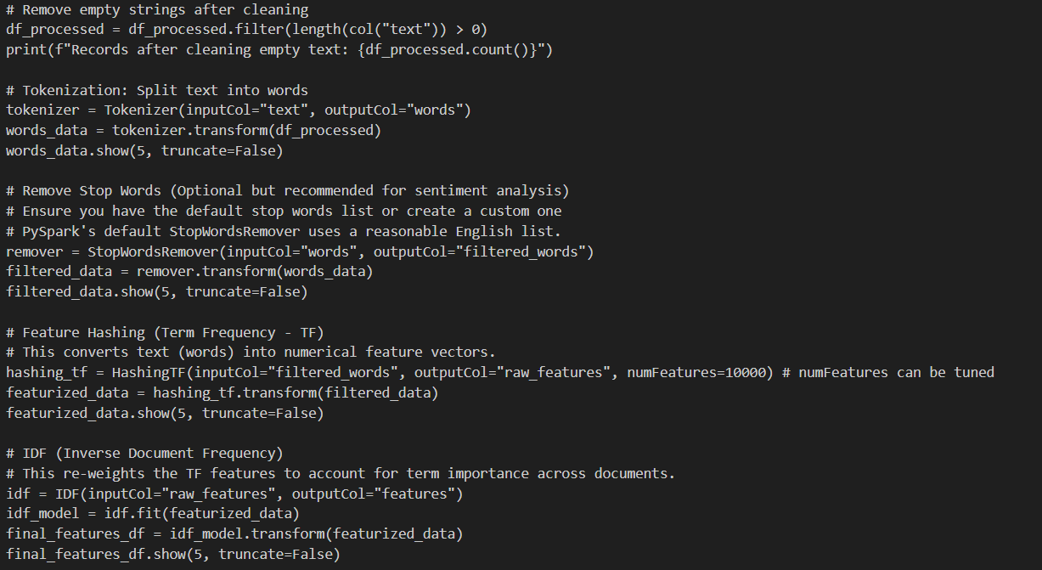
STEP 3

Slide 9
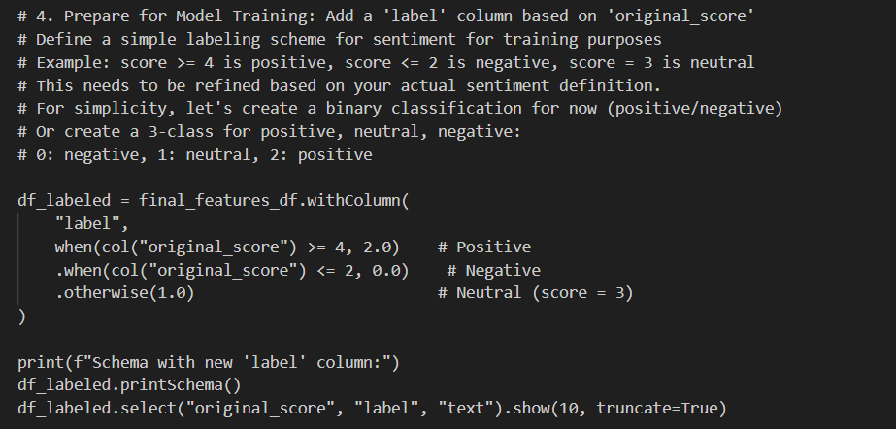
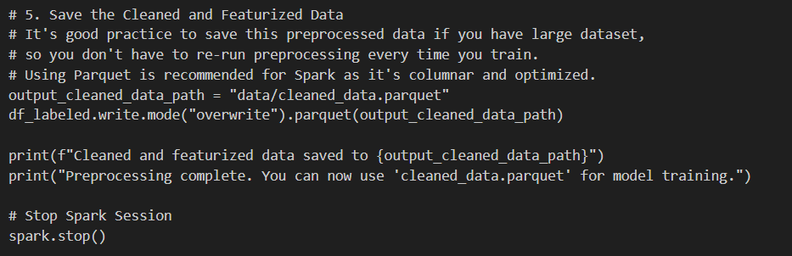
STEP 4
STEP 5

Slide 10
MODEL TRAINING
LOGISTIC REGRESSION

Slide 11
MODEL TRAINING
LOGISTIC REGRESSION
1
2
3
Initiate Spark Session
Load Cleaned Data
Prepare Label Data for Model Training
4
Split Dataset
5
Train Logistic Regression Model
6
Evaluate Model
7
Save Trained Model

Slide 12
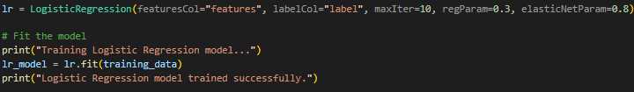
MODEL TRAINING
LOGISTIC REGRESSION
PREPARE LABEL DATA FOR MODEL TRAINING
LOAD CLEANED DATA
Source: data/cleaned_data.parquet
"features" → Vector of word features
"label" → Numeric sentiment label:
0 = Negative
1 = Neutral
2 = Positive
SPLIT DATASET
TRAIN LOGISTIC REGRESSION MODEL
80% for Training
20% for Testing
Model fitted on Training Data

Slide 13
MODEL TRAINING
LOGISTIC REGRESSION
EVALUATE MODEL
Metric | Value
F1 Score | 0.8382
Accuracy | 0.8557
Precision | 0.8285
Recall | 0.8557

Slide 14
VISUALISATION

Slide 15


Elasticsearch and Kibana in version 8.17.4

Slide 16
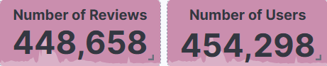
NUMBER OF REVIEWS AND USERS
454,298 unique users and 448,658 review records observed
Slight gap indicates not all users leave reviews
Reflects common user behavior—usage without feedback
Highlights difference between active and engaged users
Useful for understanding true sentiment contribution and participation level

Slide 17
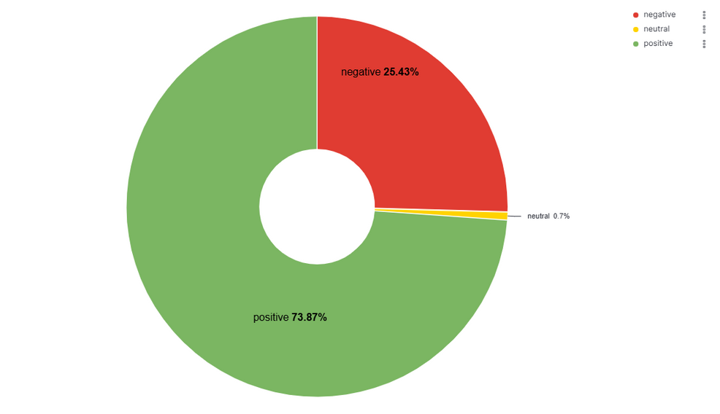
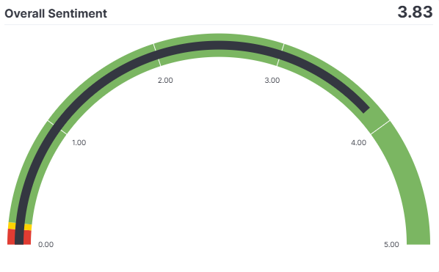
SENTIMENT PERCENTAGE
Dataset size: 448,658 entries
Positive sentiment: 73.87% (majority)
Negative sentiment: 25.43% (significant portion)
Neutral sentiment: 0.7% (negligible)
Overall: Strong skew toward positive sentiment
OVERALL SENTIMENT
Average sentiment score: 3.83 out of 5
Derived from the original_score field in reviews
Gauge ranges:
0–0.11: Negative (Red)
0.11–0.16: Neutral (Yellow)
0.16: Positive (Green)
3.83 score falls in the positive zone, indicating strong user satisfaction

Slide 18
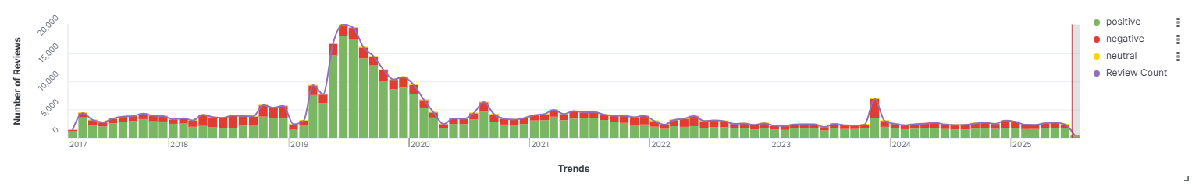
TREND OVER THE YEARS (REVIEWS)
Covers review trends and sentiment from 2017 to mid-2025
Major spike on June 1, 2019 with 20,288 reviews, mostly positive
Review volume falls below 5,000/month from mid-2020 onward
November 1, 2023 shows a rise to 6,953 reviews, with negative sentiment nearly equal to positive
Positive sentiment consistently dominates over time
Stacked bar chart displays sentiment: green (positive), red (negative), yellow (neutral)
Effectively visualizes shifts in user satisfaction and key engagement periods

Slide 19
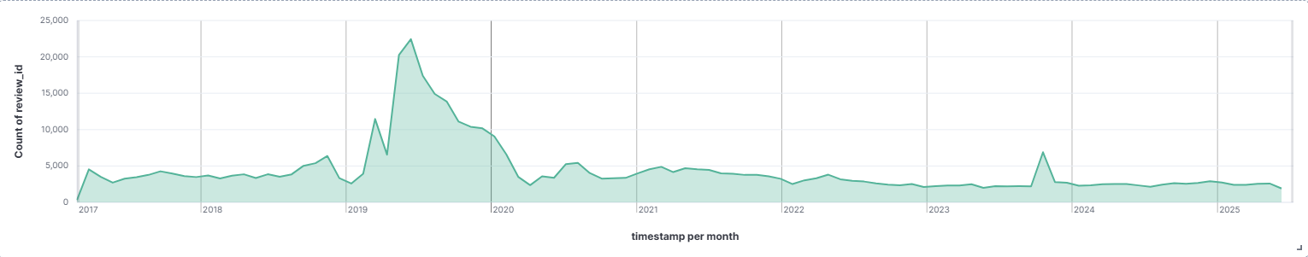
TREND OVER THE YEARS (USERS)
New users spans from 2017 to mid-2025.
Major spike in June 13th 2019 with 22,436 users — likely a product launch or campaign.
New users volume declines steadily post-spike, staying under 5,000 from 2020 onward.
Minor peak around November 10th 2023 with nearly 6,895 new users— possible issue or update.
Trend reflects typical lifecycle: high engagement early, gradual drop over time.

Slide 20
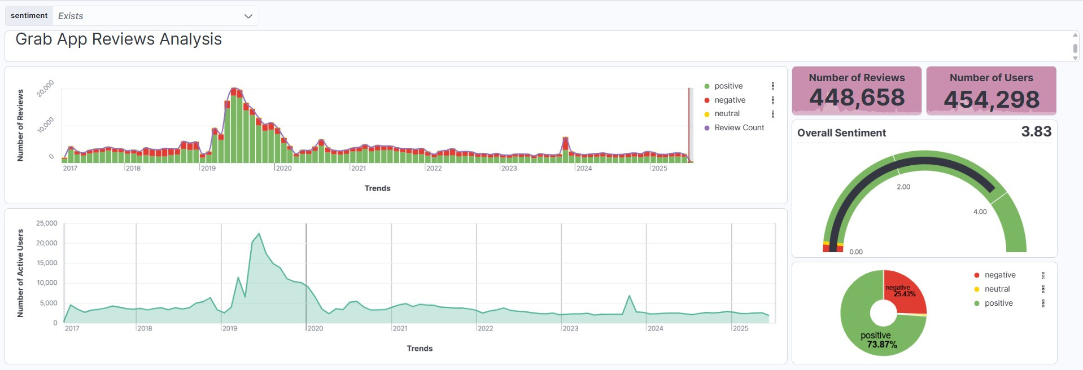
DASHBOARD

Slide 21
THANK YOU !

